Slide 1



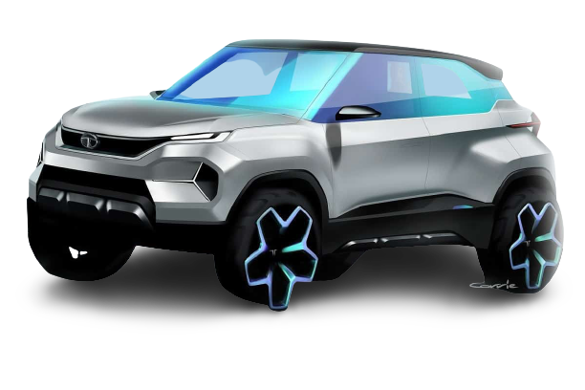

ID 80
TATA
Company Corporation
Monu Saini
TATA AMBANI

